Slide 1
Setup and Timing
Setup:
MakeCode for micro:bit app (aka.ms/microbitapp) launched and on Home Page
Timing (45):
Intro to the micro:bit (5)
Getting Started with MakeCode (10)
Radio Project (15)
Hardware (10)
Close (5)

Slide 2
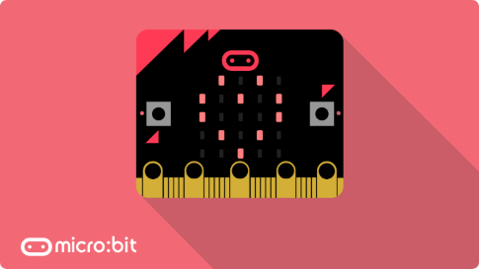
Microsoft MakeCode for the micro:bit
Student Zone – Build It
Notes:
Introduce speaker/helper – Name, What you do at Microsoft, What you studied in School
These are beginner level labs.
There is a big diversity of experience here, and we don’t want to leave anyone behind.
If you are more advanced – please help others, code in JavaScript (we’ll be running these labs in Blocks), and feel free to add more complexity and experiment with your projects
There is also a DIY area with more micro:bits available if you want to continue working on your projects and programs after this lab

Slide 3
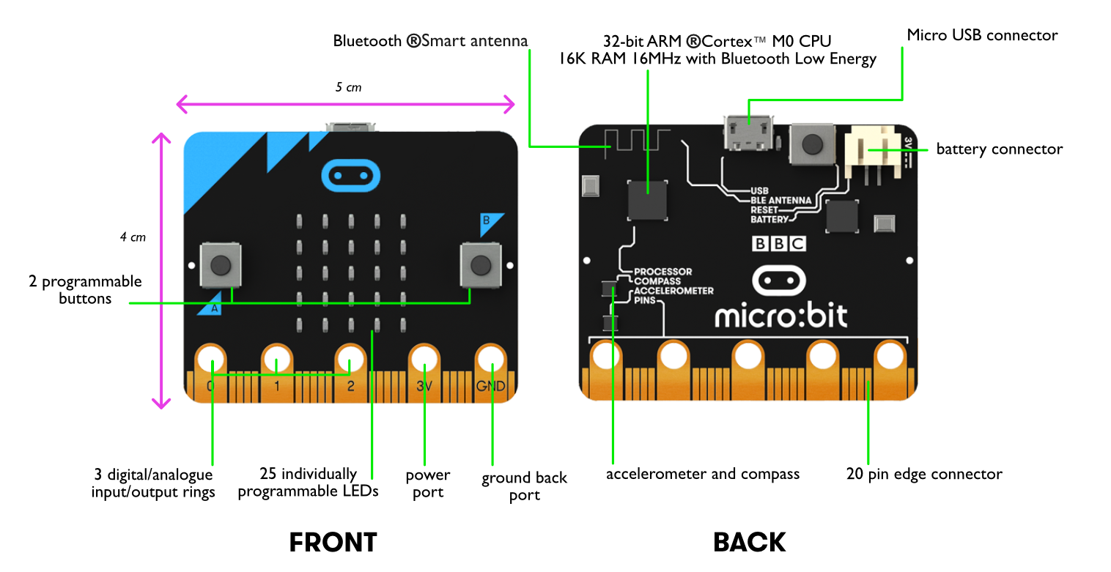

http://microbit.org/hardware/
Notes:
The micro:bit is something called a micro-controller board.
You can think of it as a mini-computer
Here are some of the components on the micro:bit:
Front -
5 x 5 matrix of red LED lights
Light sensor built into the LED’s
2 programmable buttons (A, B and A+B)
3 IO rings and 20 Pins
Power (3V)
Ground (GND)
Back –
USB port
Reset button
Battery connector
Processor and memory chip (16K RAM – tiny! Compared with most modern PC’s today with 4GB of RAM)
Compass – measures magnetic force
Accelerometer – measures motion
Bluetooth antenna – for radio communications between micro:bits which we’ll use later

Slide 4
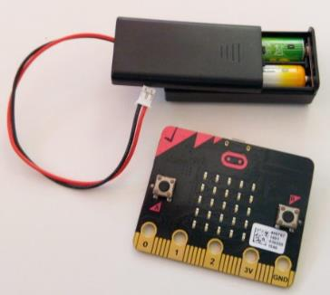
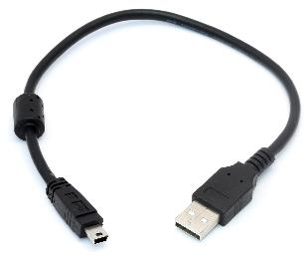
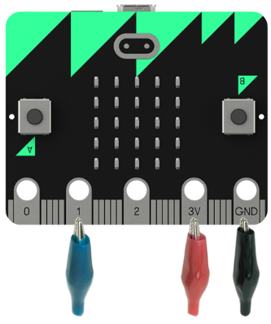
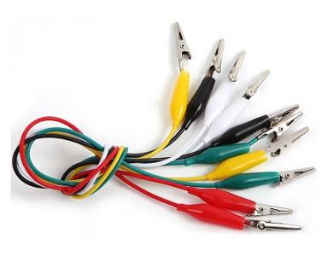
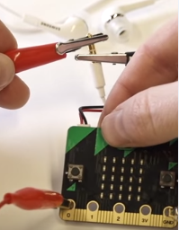
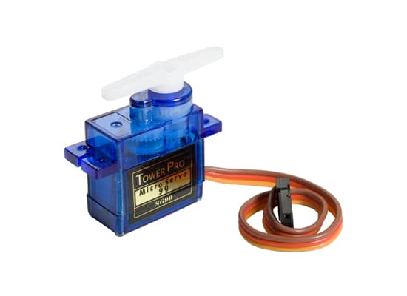
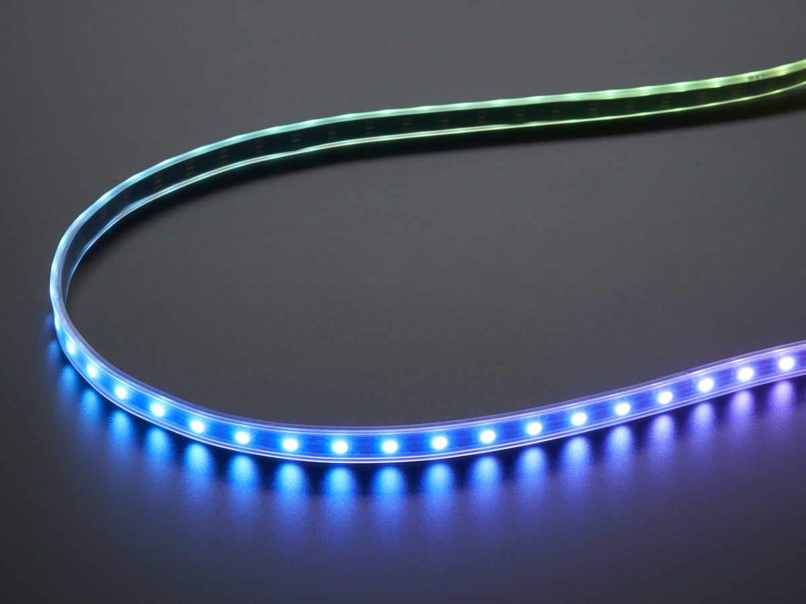
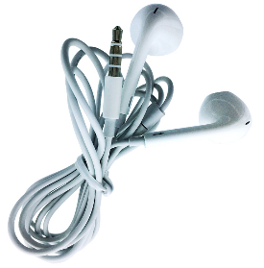
Micro:bit Kits & Accessories
Battery Pack & USB cable
http://microbit.org/resellers/
$16
Crocodile Clips
Speakers/ Headphones
NeoPixels
Servo Motors
Notes:
Micro:bit kits cost about $16, and there are many, many, many kits and accessories you can get for your micro:bit
Crocodile clips are cables you can use to connect electronic components together
We’ll be using a speaker, servo motors and a neopixel strip in the lab today

Slide 5
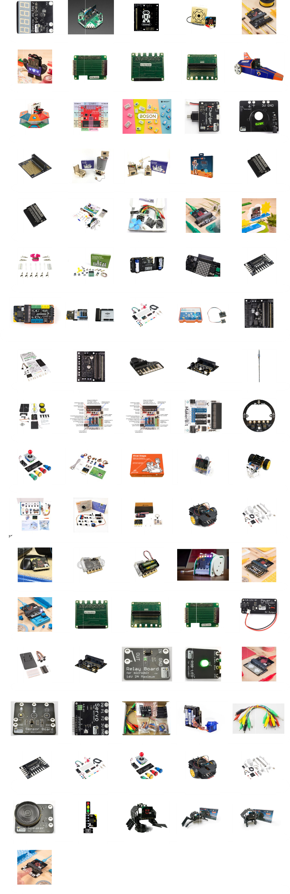
Notes:
But there are many more different kits and accessories that work with the micro:bit

Slide 7
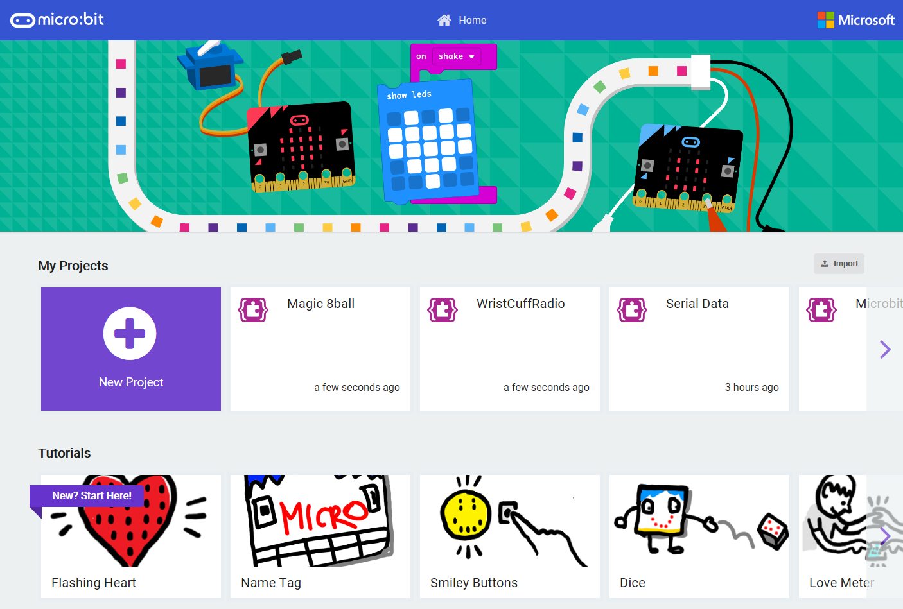
MakeCode for the micro:bit
Import program files (.hex) or shared project URL’s
Recent projects
Step-by-step Tutorials, Sample Projects, Curriculum, Videos
Notes:
Open up the MakeCode micro:bit app on your computer
You should see a Home Screen like this
There are step-by-step tutorials, projects, videos and code samples available from this page
On this Home page, you can also see a list of your recent projects and you can import existing programs via a shared URL or file
Go ahead and click to create a New Project

Slide 8
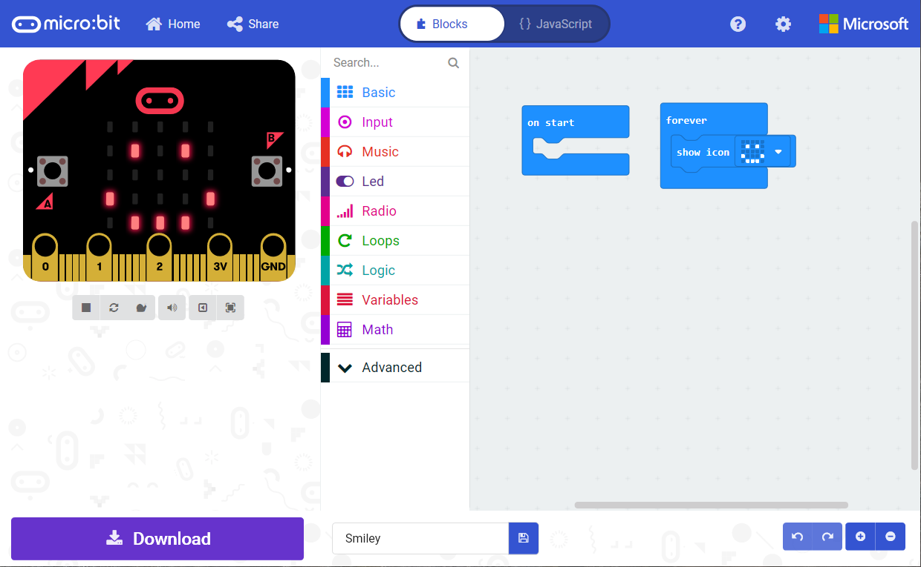
Share your Project
Go back to Home Page
Program in either Blocks or JavaScript
Block Toolbox
Programming Workspace where you will build your program
Simulator shows what your program will look like running on a micro:bit
Simulator Toolbar
Undo/Redo and
Zoom Workspace
Download your Project to the micro:bit
Name your Project and Save it on your computer
Notes:
This is the MakeCode editor
On the left side of the screen you’ll see something that looks like a micro:bit – this is an interactive Simulator and will show you what your code will look like. It’s good for testing and debugging your code.
In the middle is the Block Toolbox – which contains different categories of blocks that you can use in your program
On the right side is the Programming Workspace – where we’ll be building our program

Slide 9
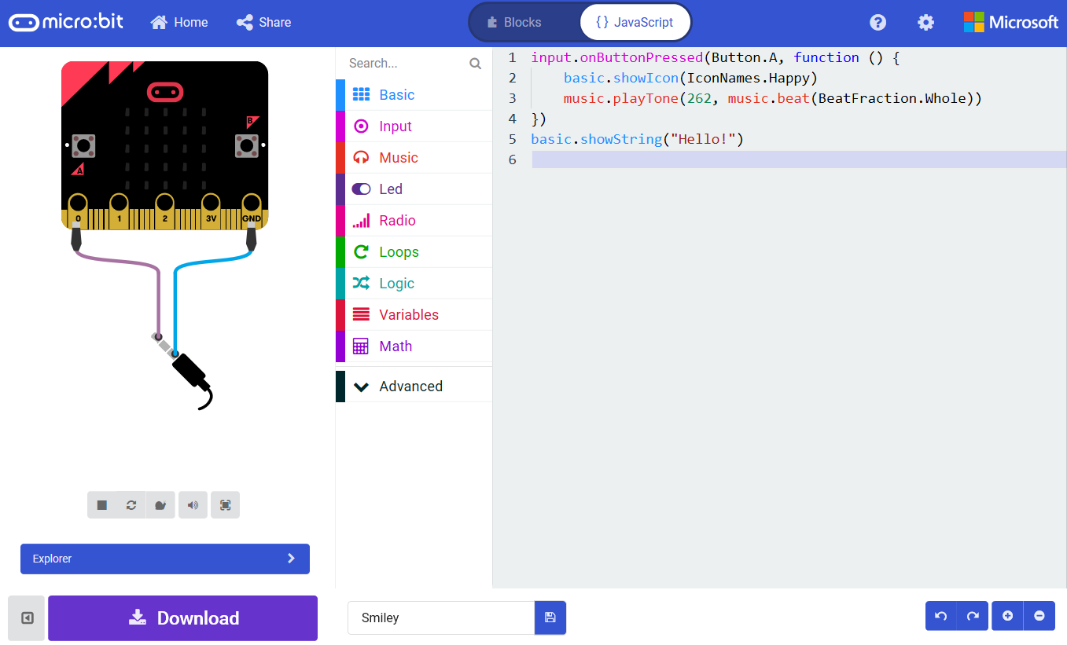
Notes:
Using the Toggle button on the top, you can switch into the JavaScript editor
More advanced students should feel free to program in JavaScript – there is intellisense, code completion and error detection to help you.
You can also use the Toolbox to drag out code snippets into the programming workspace.

Slide 10
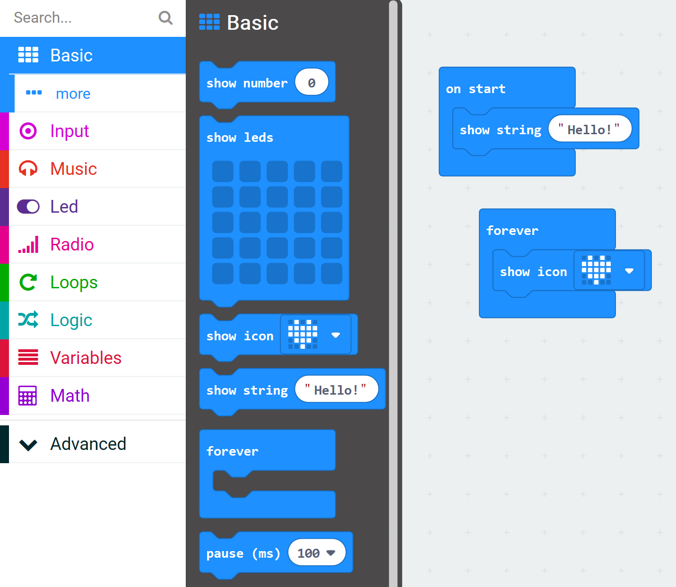
Basic Blocks

Slide 11
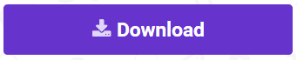
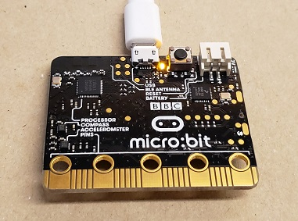
Download your program to the micro:bit
Make sure your micro:bit is plugged into the computer
Click Download Button
The Yellow light on the back of your micro:bit will flash while your program is downloading

Slide 12
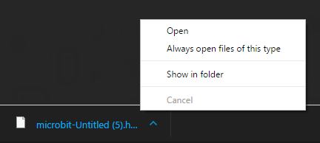
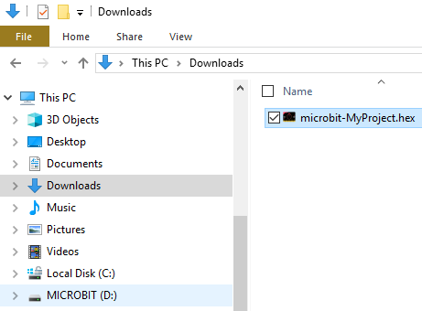
Download your program to the micro:bit
Plug in your micro:bit with USB cable
Click Download Button
Edge: Click Save As
Chrome: Select Show in folder
Copy your file over to the micro:bit USB drive

Slide 13
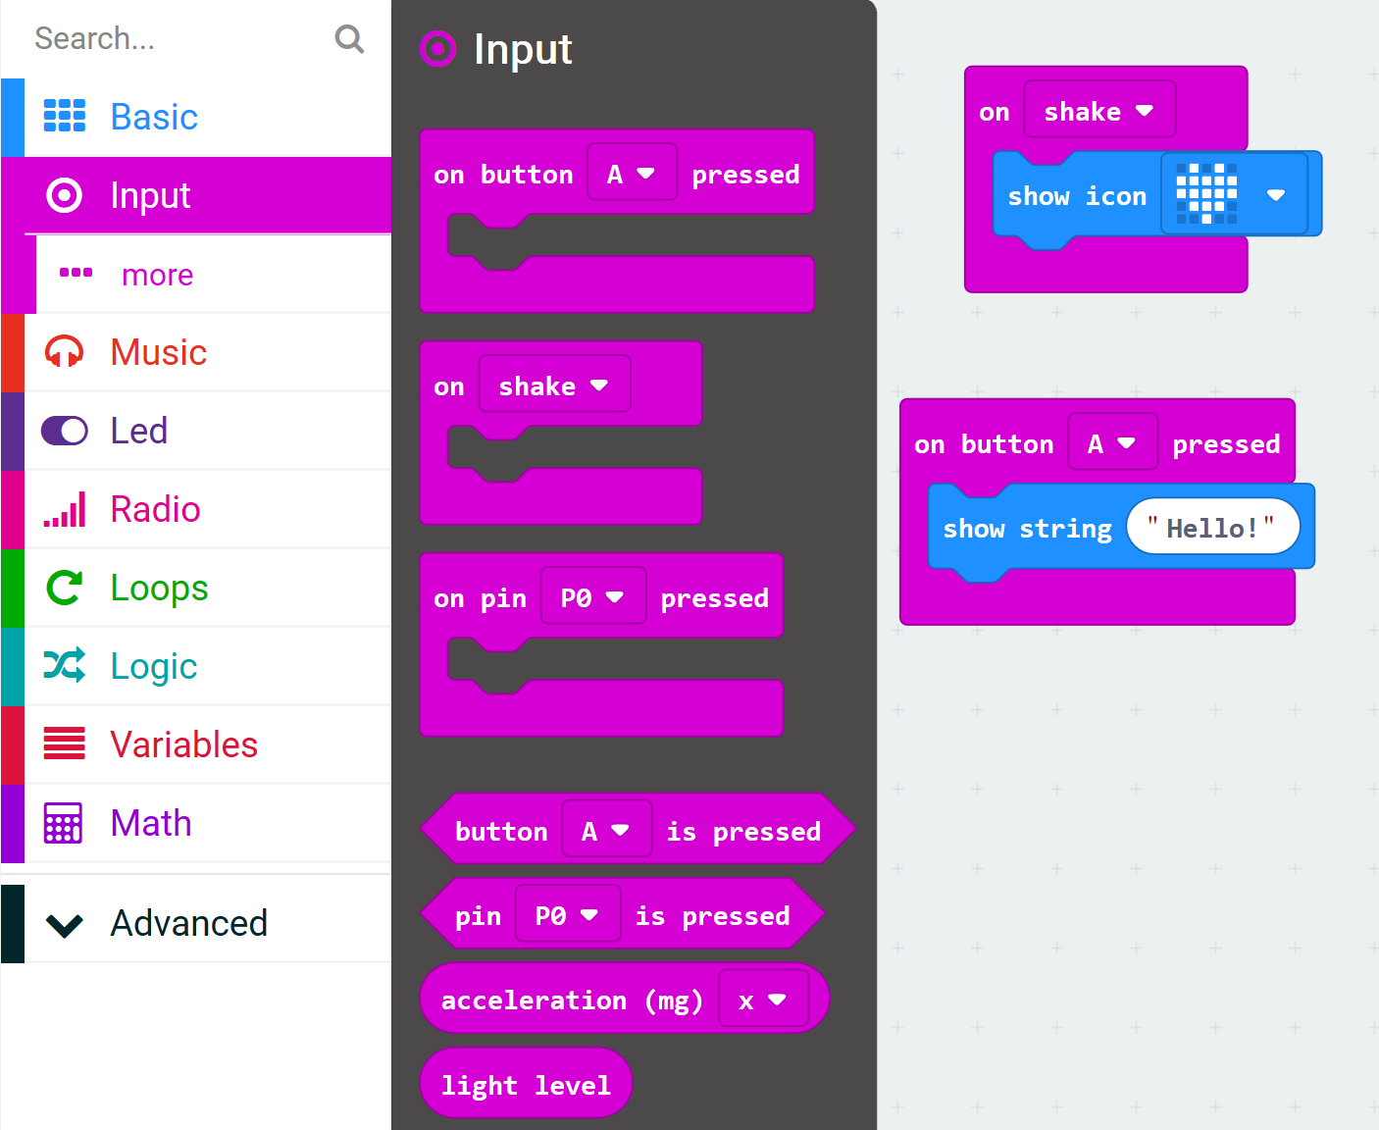
Input Blocks

Slide 14
Download your program to the micro:bit
Make sure your micro:bit is plugged into the computer
Click Download Button
The Yellow light on the back of your micro:bit will flash while your program is downloading

Slide 15
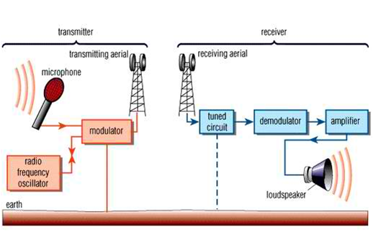
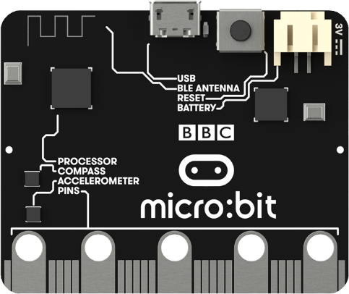
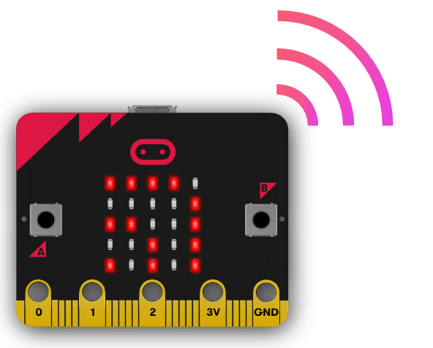
Radio Communications
Frequency
Transmitter
Receiver

Slide 16
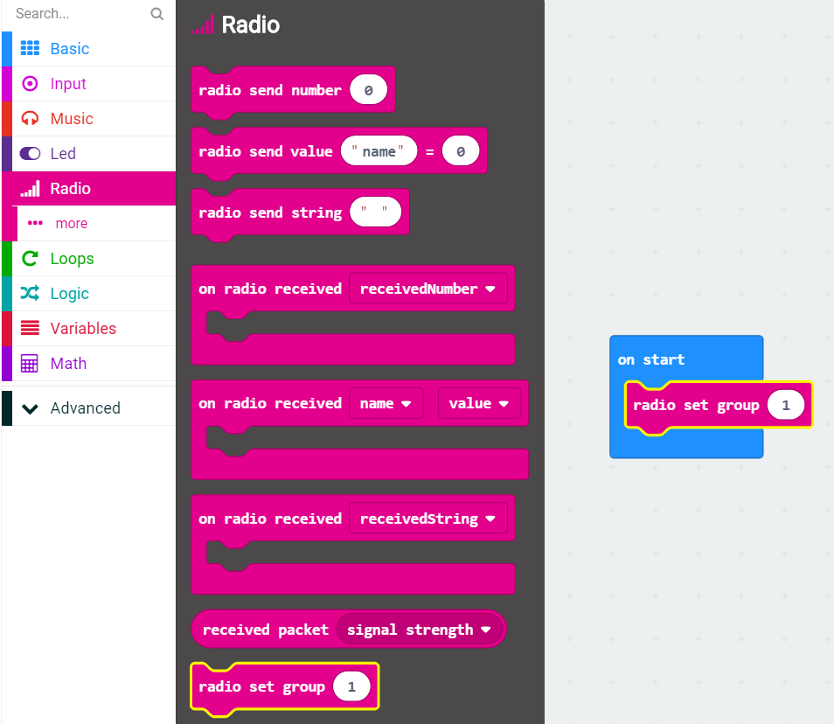
Radio Blocks
Everyone communicates across the same Radio Frequency – Group 1

Slide 17
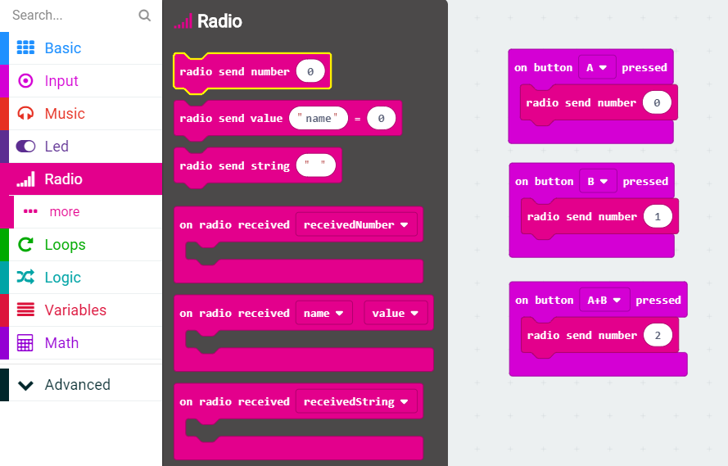
Radio Blocks
Buttons
A
B
A+B
Radio Send Number
0
1
2

Slide 18
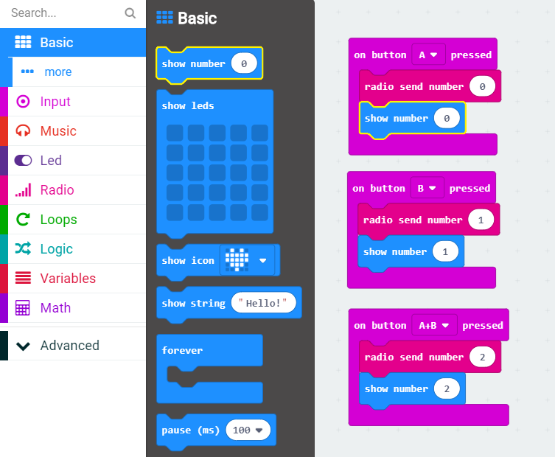
Show the Number being sent
Drag out three Show Number blocks
Place in each On Button Pressed block
Type in 0, 1 or 2

Slide 19
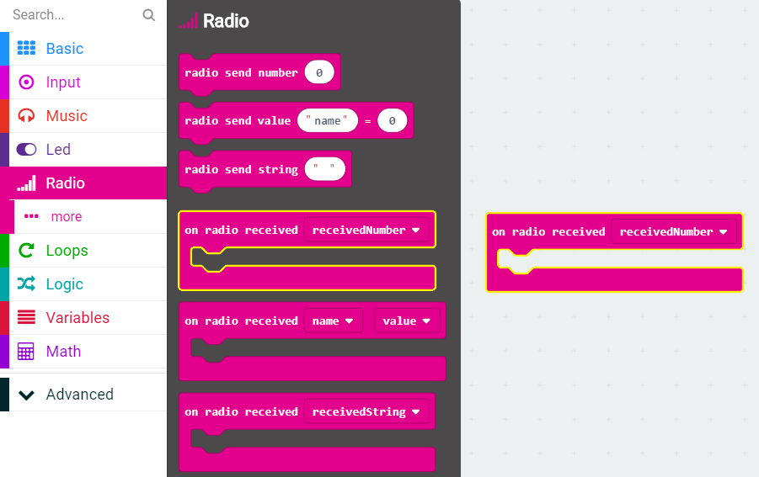
Receive the Number
Received Number

Slide 20
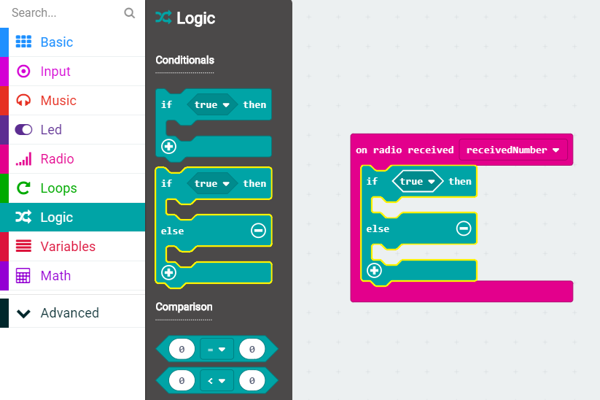
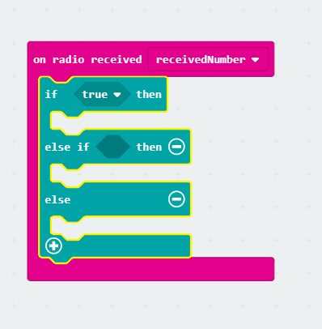
Check the value

Slide 21
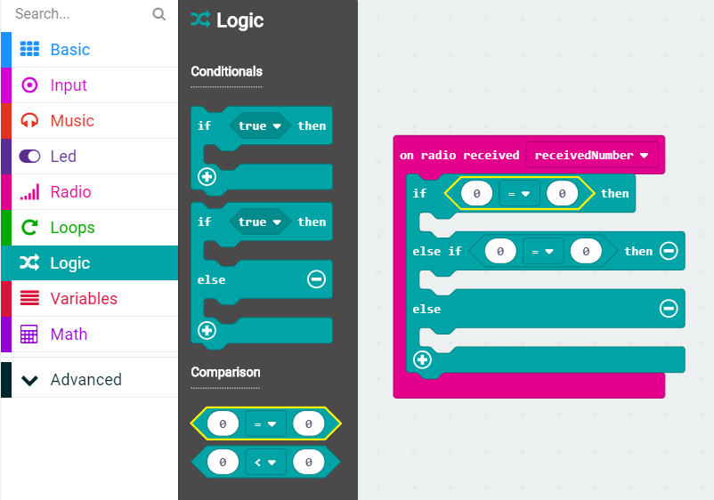
Check the value
Drag out two Equals Comparison blocks
Drop in If and Else If clauses

Slide 22
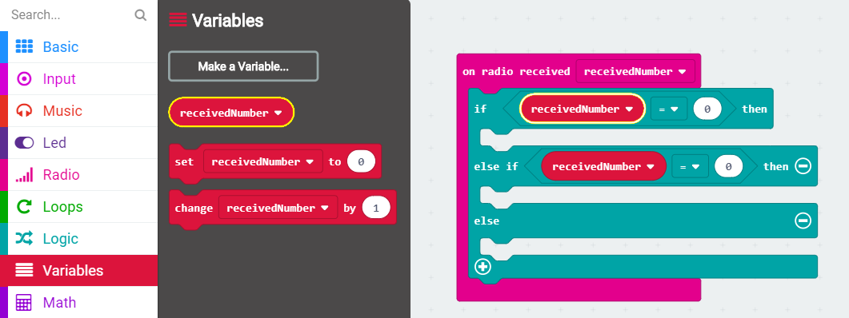
Check the value
Drag out two receivedNumber variable blocks
Drop in the first slot of each Equals Comparison block
Change the value of the second number to 1

Slide 23
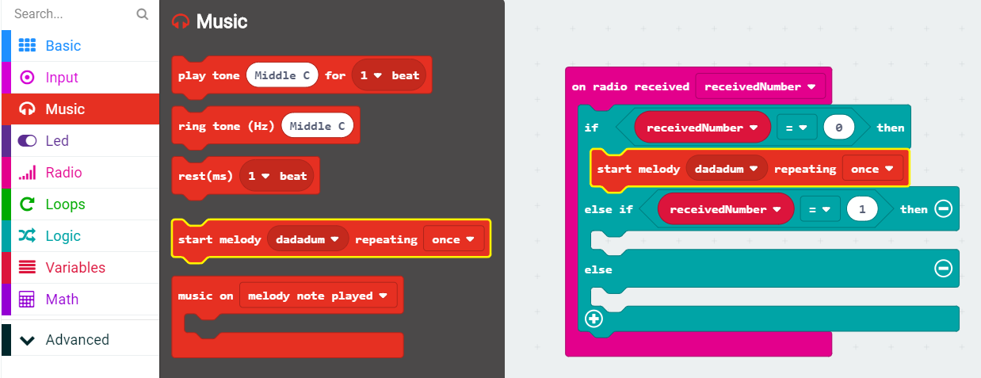
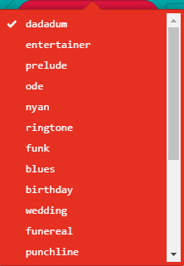
0 = Play Music

Slide 24
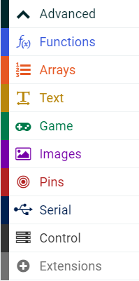
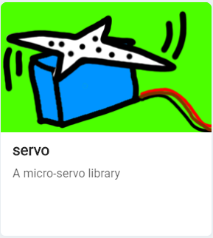
Add Servo Motor blocks
In the Toolbox, click on Advanced | Extensions
Select Servo Motor library

Slide 25
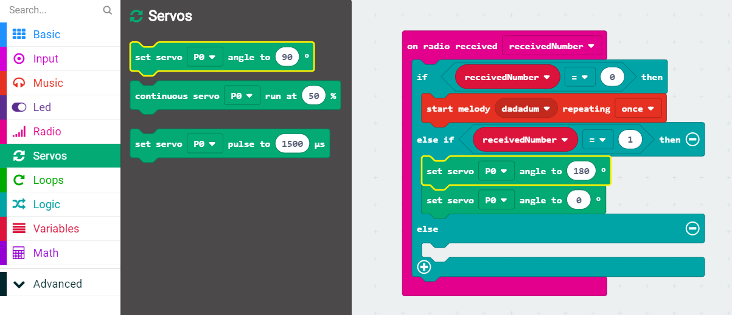
1 = Move a Motor
Drag two Set Servo blocks to the Else If clause
Set angles to 180 and 0

Slide 26
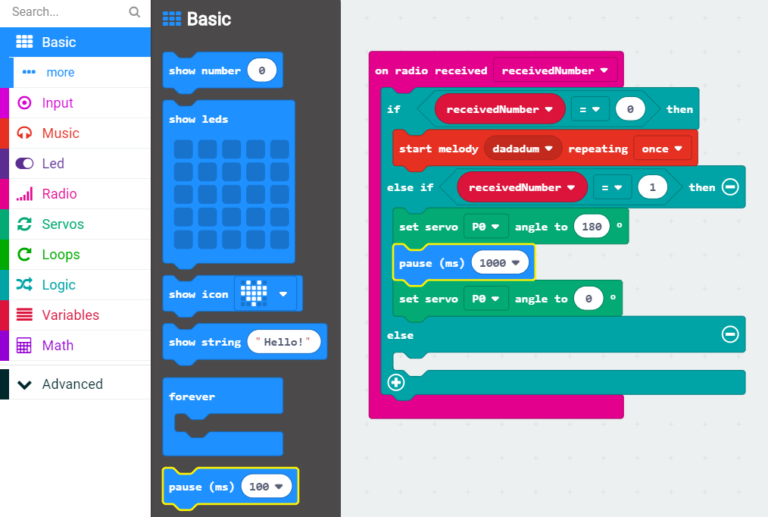
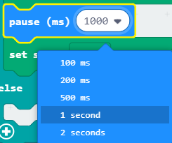
1 = Move a Motor
Add a Pause for 1 second between them

Slide 27
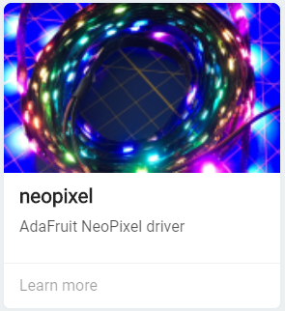
Add NeoPixel blocks
In the Toolbox, click on Advanced | Extensions
Select NeoPixel library

Slide 28
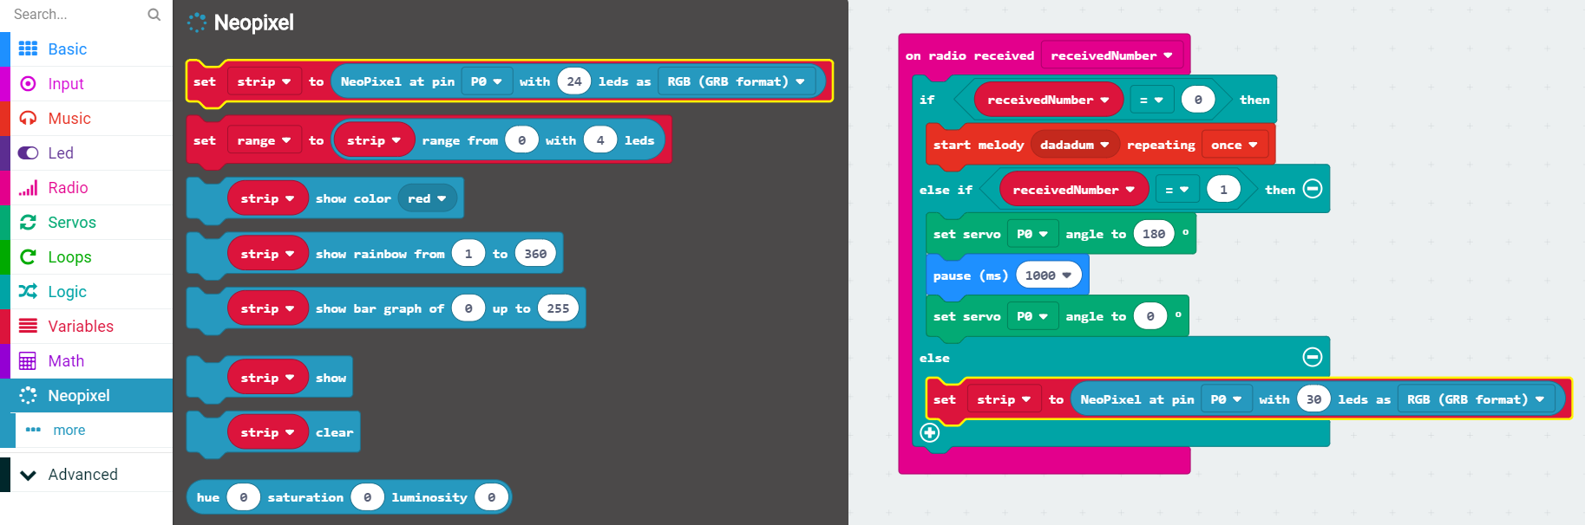
2 = Rainbow Lights
Drag a Set Strip block into the Else clause
Set the number of LED lights to 30

Slide 29
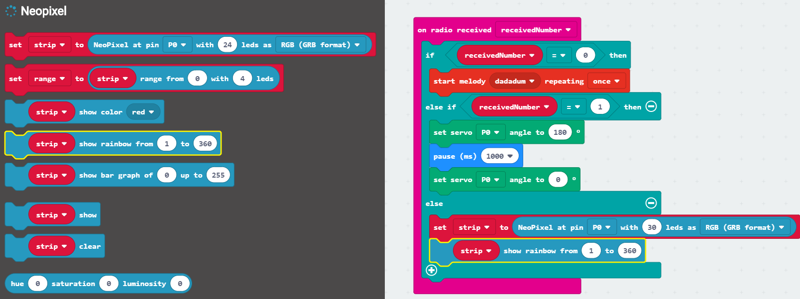
2 = Rainbow Lights
Drag a Strip Show Rainbow block after the Set Strip block

Slide 30
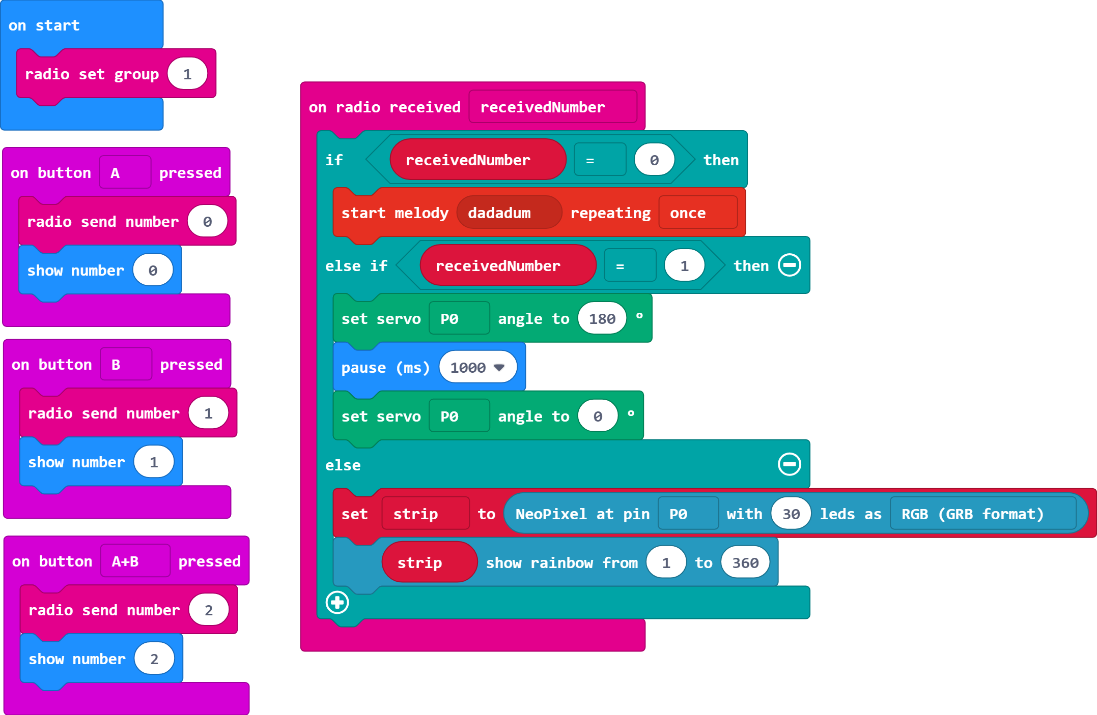
Complete Program
Notes:
https://makecode.microbit.org/_D5XA00MycVoY

Slide 31
Download your program to the micro:bit
Make sure your micro:bit is plugged into the computer
Click Download Button
The Yellow light on the back of your micro:bit will flash while your program is downloading

Slide 32

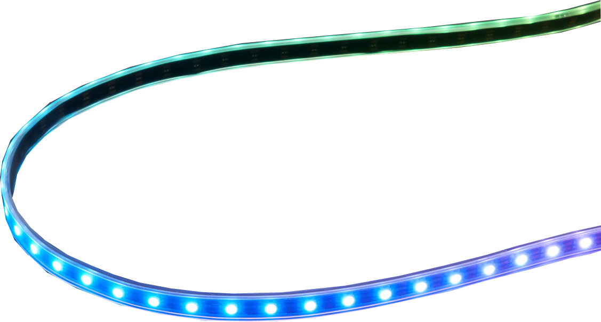
Micro:bit Accessories
At your table,
Pick 2 people for each accessory
0 Speaker
1 Servo Motors
2 NeoPixels
2 People on Speakers
2 People on Motors
2 People on NeoPixels

Slide 33
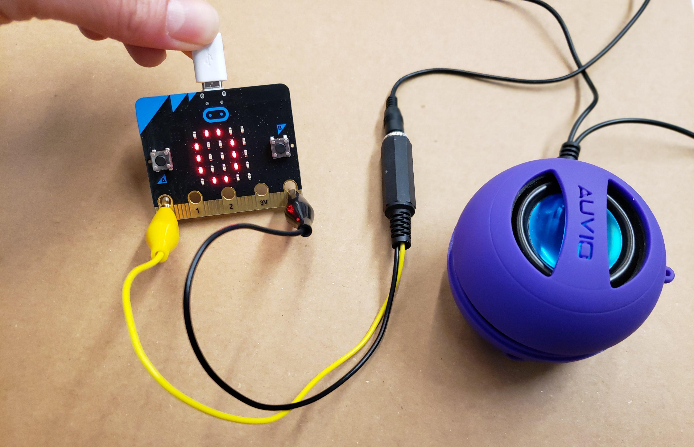
Attach Speaker to micro:bit via Croc Clip Cables

Slide 34
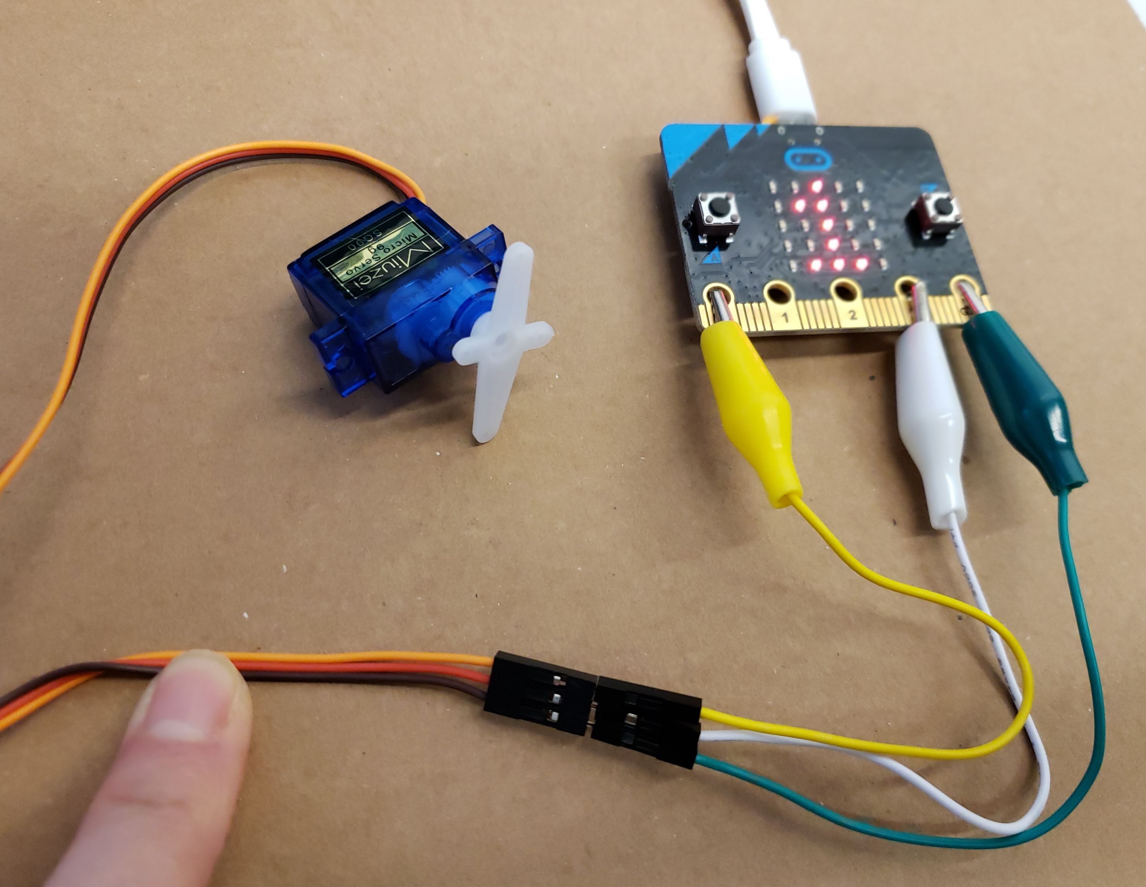
Attach Servo Motor micro:bit via Croc Clip Cables
Orange = P0 (data)
Red = 3V (power)
Brown = GND
(ground)

Slide 35
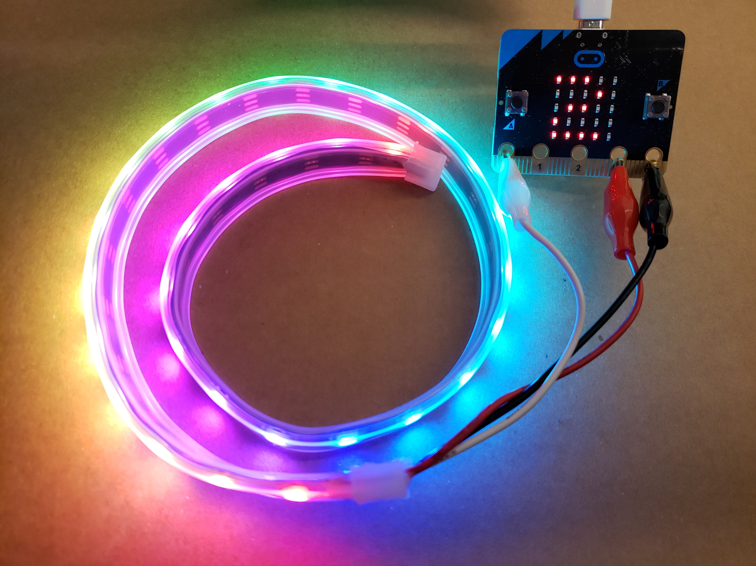
Attach NeoPixel strip to micro:bit via Croc Clip Cables
White = P0 (data)
Red = 3V (power)
Black = GND (ground)

Slide 36
Run the Program
Press Button A to play Music!
Press Button B to move Servo motors!
Press Buttons A and B together to turn on NeoPixel lights!

Slide 37
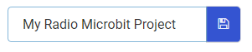
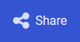

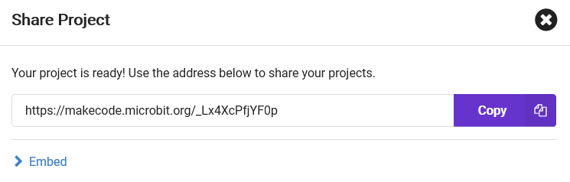
Share your Code
Give your program a name
Click the Share button in the top left
Click the Publish Project button
Copy the URL somewhere (or take a picture)

Slide 38
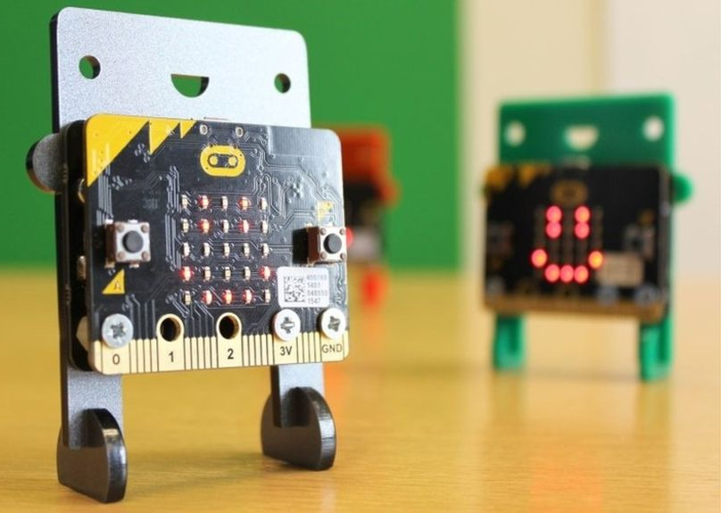
Extension Ideas
Use Radio Groups to send secret messages
Create a pedometer to track steps using the accelerometer values
Compose your own songs using the Play Tone blocks
Build a robot using servo motors
Create a ‘catch the light’ game using a NeoPixel strip
Notes:
Here are a few more ideas for coding with your micro:bit
Feel free to explore more at the DIY area where we have micro:bits and additional accessories for you to use

Slide 39

MakeCode for the micro:bit
Please fill out Survey! – aka.ms/SurveyMB
More about MakeCode – makecode.com
More about micro:bit – microbit.org
Notes:
Any last questions before we wrap up?
Here are some links for where you can continue coding using the MakeCode web editors at home, and where you can get more information about the micro:bit
Thanks so much for attending!

